Slide 1
Counterfactual Interpolation Augmentation (CIA)
A unified approach to enhance fairness and explainability of DNN
Yao Qiang , Chengyin Li , Marco Brocanelli and Dongxiao Zhu
Presentation by: Kevin Richard
Course: CPS-592

Slide 2
Motivation
Fairness:
It refers to the concept of treating individuals or groups equitably, without discrimination or bias to make decisions that do not perpetuate or amplify biases that may exist in the data or in society.
Explainability:
It is the ability to understand how a model or algorithm arrived at a particular decision or prediction. This is important to ensure that the decision-making process is transparent and can be trusted.

Slide 3
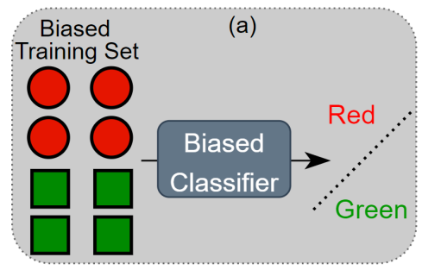
Why check Fairness?
The Training set is biased:
All the circles are Red
All the square are Green
The Biased classifier learns that all red data are circles and green inputs are squares.
So, when a green circle is predicted, it could mistake it as a square instead.
This situation occurs because the training data set is biased and not fair.
The following model is to predict shapes

Slide 4
Main Concepts
Counterfactual Interpolation Analysis (CIA) : Minimize Bias (or) ensure Fairness
Path Integral of Counterfactual Gradient (CGI) : Explainability
Counterfactual: (What-if data) It is duplicate data with one or more features changed.
Example : in data to check for apples and bananas, it creates a duplicate data of an apple but with colour=yellow.
Interpolation: It is the creation of multiple data points between two known values.
Gradient : Vector of partial derivatives of a function with respect to its input variables. It is used to update the parameters in gradient descent.

Slide 5
Related Work
1) Debiasing Learning
In-processing
In-processing approaches aim to remove the sensitive information from the learned features during the training process.
But model may behave differently during training & inference, though fairness constraints satisfied during training.
Post-processing
Post-processing approaches calibrate or modify the predictions according to the sensitive attribute at inference time.
They require access to sensitive attributes which is not feasible due to security & privacy concerns.
Pre-processing
Pre-processing approaches attempt to debias and increase the quality of a training set through data augmentation. This paper advocates pre-processing.

Slide 6

Related Work
2) Integrated Gradients and Variants
Gradient-based feature attribution techniques interpret DNN in terms of the gradient, i.e., the partial derivative of the output with respect to the input.
Integrated Gradients (IG) applies integrated gradients along a linear path from a baseline to the input avoiding the well-known problem of gradient saturation, i.e., the gradients may not reflect importance of features.
The linear integral path is denoted as :

Slide 7
Related Work
Integrated Gradients and Variants (continuation..)
Studies demonstrate that the choice of baseline heavily impacts the quality of feature attributions.
Here are some of the existing baselines:
1) Maximum distance baseline 2) Blurred baseline
3) Gaussian baseline 4) Uniform baseline.
It is noted that the existing choices of the baseline critically impact attribution quality, leading to unfair explanations in the debiasing learning scenario.
To overcome this, a new attribution based technique is developed, which integrates gradients along the counterfactual interpolated path to achieve a higher explanation quality.

Slide 8
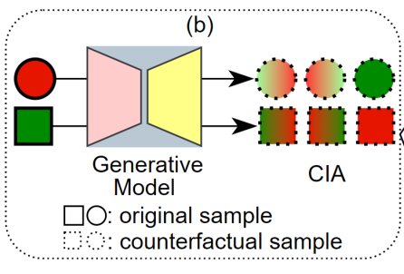
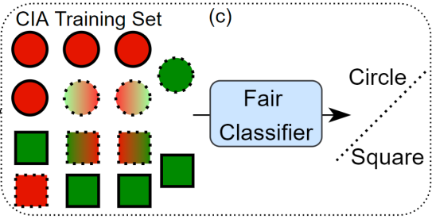
What does CIA do?
It takes the sensitive data such as colour and creates counterfactual data where sensitive data like colour is changed. This de-sensitizes colour when training the model and makes it concentrate on other features instead. ( Hopefully the shape in this case )

Slide 9


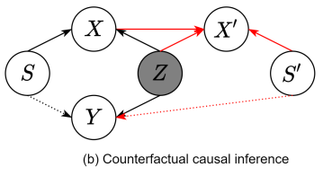
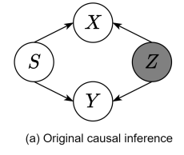
Proposed Method (Fairness)
1) Counterfactual Causal Inference
It involves building models that can simulate different outcomes based on different hypothetical scenarios.
Defnition 1: A classifer Yˆ is counterfactually fair
if under any context X = x and S = s, for all y and for any value s ′ attainable by S.
We further require the model to be counterfactually
fair, conditioning on the factual target y, formally:
The data bias problem is caused by the distribution of
sensitive attribute p(S), e.g., s is randomly drawn from
a multinomial distribution.
We model the counterfactual causal inference to generate counterfactual interpolation augmentations illustrated in Figure (b). A counterfactual generative process is x ′ , y = p(X′ |Z, S′ )p(Y |Z, S′ ), and here S ′ is a new confounding variable in contrast with S.

Slide 10
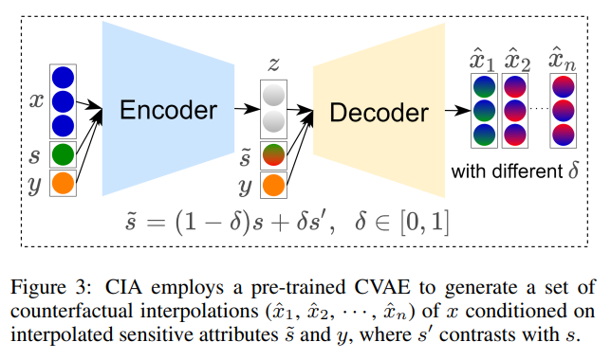
Proposed Method (Fairness)
2) Generating Counterfactual Interpolations
We first pre-train a generative model in which the encoder and decoder inputs are conditioned on the sensitive attribute and target variable
The generative model is trained to minimize the following objective function:
CVAE can generate non-existent manipulated samples as interpolations for real samples along any arbitrary axis.
The variation of δ determines the number of generated interpolations.

Slide 11

Proposed Method (Explainability)
Training Fair DNN with CIA
By adding the generated counterfactual interpolations XCIA, we obtain our augmented training dataset
The debiased model is then trained with the cross-entropy objective:
2) Counterfactual Gradients Integration
IG’s performance heavily relies on the choice of baseline. An arbitrary choice could negatively impact the explanatory power and lead to meaningless explanations.
Counterfactual Gradients Integration (CGI), leverages the counterfactual interpolations generated from CIA to artificially induce a procedure on how the model attention moves across the gradual changes on the sensitive attribute of the input while computing the final prediction score.
Thus, CGI can generate explanations regardless of bias while querying a fair DNN model for gradients.

Slide 12


Proposed Method (Explainability)
3) Path Integral of CGI
In CGI, we design the path integral as the interpolated path, transiting from the counterfactual sample x ′ to the input x for generating counterfactual interpolations in CIA.
We formulate CGIi(x) along the i-th dimension for an input x and its counterfactual example x ′ as:
CGI is obtained by accumulating the gradients along the integration path γ(δ) by varying the δ parameter. The model will encounter interpolations on the sensitive attribute from s ′ to s during the CGI process.
IG only provides a measure of the importance of features in making the prediction but does not give any specific information on how changing a feature affects the prediction.
CIA is more explainable because it explicitly generates counterfactual examples that show how a change in a particular feature or attribute affects the prediction or outcome.

Slide 13
Datasets
BiasedMNIST
MNIST dataset is popularly used for benchmarking computer vision models.
Here MNIST is modified by introducing color as the sensitive attribute correlating strongly with the target labels in the training set.
The encoder and decoder in CVAE for BiasedMNIST are multi-layered perceptrons consisting of three hidden layers where the latent feature dimension is set to be 2.
We train CVAEs for 50 epochs for BiasedMNIST.
CelebA
It is a multi-attribute dataset for face recognition with 40 binary attribute annotations for each image.
HeavyMakeup and HairColor are chosen as target attributes (y) and Gender as the sensitive attribute (s).
The encoder of CVAE has 4 × Conv2D layers with a 3×3 kernel. The decoder consists 4 × Conv2DTranspose layers with a 3×3 kernel.
We train CVAEs for 20 epochs for CelebA.

Slide 14
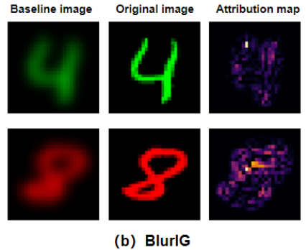
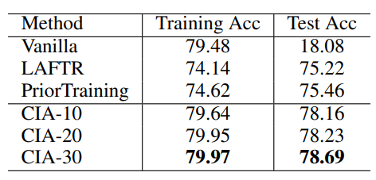
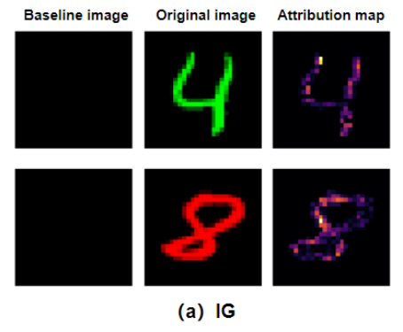
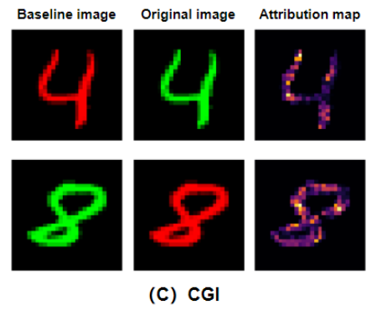
Results
1) BiasedMNIST
We compare our method with the vanilla models, LAFTR and PriorTraining.

Slide 15
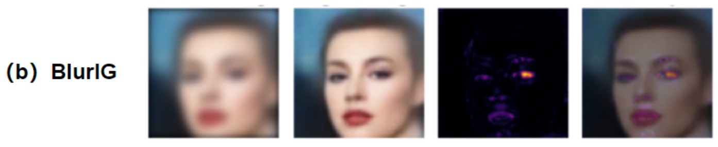
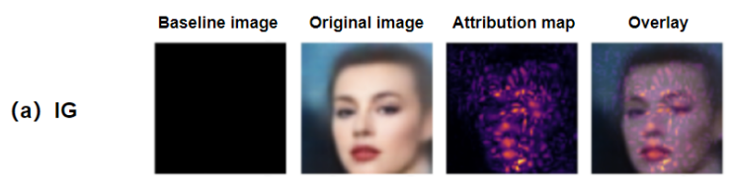
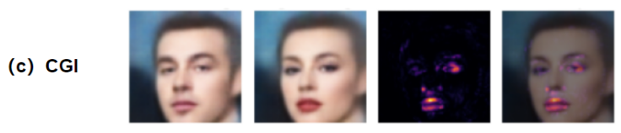
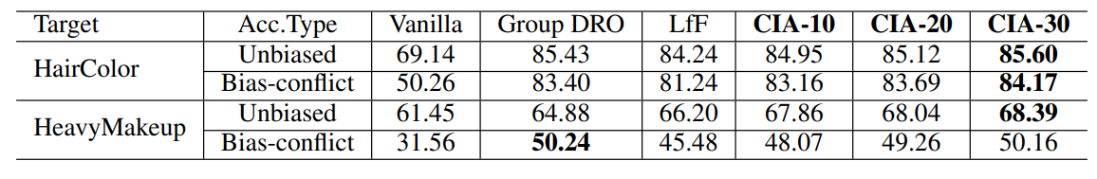
Results
2) CelebA Results
The target attribute is HeavyMakeup.
Evaluation results on CelebA. Where Gender is the sensitive attribute.

Slide 16
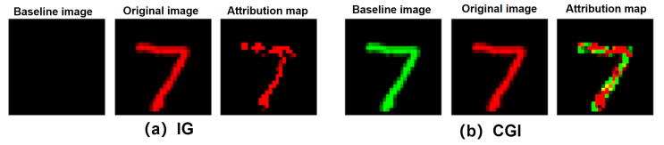
Takeaways
1) Fair Explanation
We illustrate an example from BiasedMNIST to examine whether these methods are making fair explanations.
Both IG and CGI can generate high-quality attribution maps with clear digit shape.
While CGI’s attribution map clearly shows that the attributions are captured from the digit shape rather than the color.

Slide 17
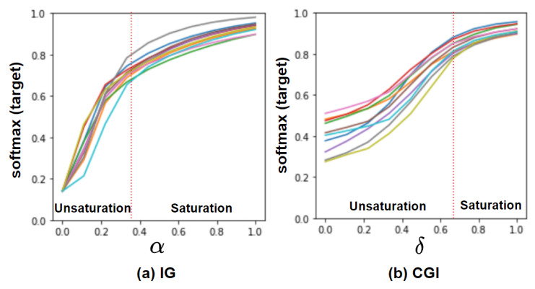
Takeaways
2) Investigating Saturation Effects
It is desirable to have a larger unsaturated region to convey feature importance via gradients integration.
Experiment is conducted to investigate the saturation regions of IG and CGI.
CGI integrates gradients in a larger unsaturated region than IG does, which contributes proportionately to the computed attribution leading to better explanations.

Slide 18
Conclusion
This approach increases fairness and explainability. CIA is proposed as a pre-processing method to improve DNN’s fairness via de-correlating the target variable with the sensitive attribute in training set.
The experimental results demonstrate the outstanding performance of this approach via quantitative and qualitative evaluations using benchmark datasets.

